Slide 1

Predict Future Sales of an item

Slide 2
Objective
To develop a predictive model that forecasts the future sales of an item for the next X days using a CSV file containing historical sales data.
The focus will be on data preparation, model training, and generating forecasts.

Slide 3
Problem Statement:
To build a data science pipeline to predict future sales of a product for the next month.
This pipeline will include essential components like data loading, data preparation, model training, and forecasting.
By following these steps, we can gain valuable insights into future sales trends and make informed business decisions.

Slide 4
Data Science Pipeline
Load data
Prepare data
Train model
Forecast

Slide 5
Load Data
Importing the CSV file containing historical sales data
Initial data checks to ensure data integrity and correctness

Slide 6
Data Cleaning and Preparation
Checking percentage of missing values for each column
Replacing missing values using forward fill
Checking for duplicate rows and removing them
Handling date-time column: Parsing dates
Filtering valid dates
Dropping helper columns
Label encoding for categorical data: promotion_article, promotion_wgr', 'promotion_global, public_holiday, school_holiday, sunday
Dropping weather-related columns: temp, dwpt, rhum, prcp, snow, wdir, wspd, wpgt, pres, tsun, coco
Omitting Sunday data as it is considered a holiday

Slide 7
Exploratory Data Analysis
Key Findings: Identified sales trends, patterns, and anomalies in the data.
Visualizations: Utilized various plots such as line charts, histograms, and boxplots to understand data distribution and relationships.
Insights: Gained valuable insights into sales performance, contributing factors, and potential areas for improvement.
I have analysed the quantity distribution by :
Time
Product Type
Sales Promotions
Weather
Correlation Analysis: To identify the relationship between features and also which features are strongly correlated to the sales quantity.
Trend Analysis: Linear Regression was used.
The sales declined from March 2021 to March 2022 by more than 50% , which makes sense as it was during Covid .
Outliers: Outliers were detected using the interquartile range method and removed.
Data was visualized again after the outliers were removed.

Slide 8
Exploratory Data Analysis
Understanding the Data
Distribution of Variables:
Analysis of distribution plot shape and skewness
Identification of outliers
Quantity Distribution Over Time:
Grouping data by time periods (e.g., monthly)
Visualizing the distribution of quantities
Quantity Distribution by Product Type:
Grouping data by product type
Visualizing the distribution of quantities

Slide 9
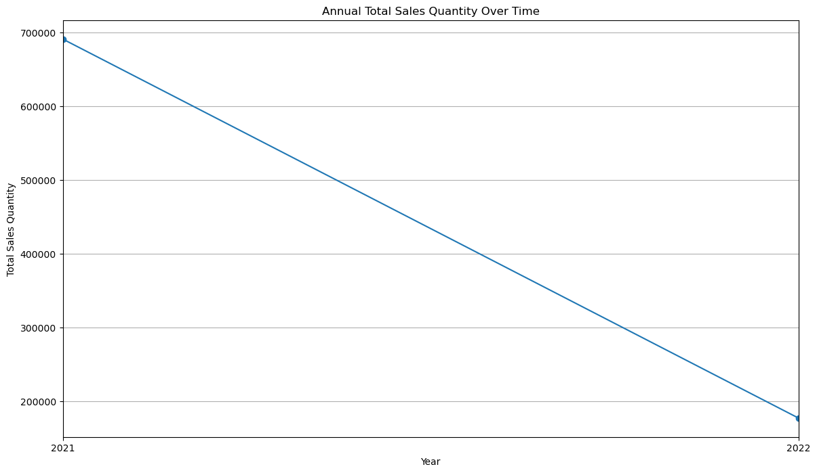
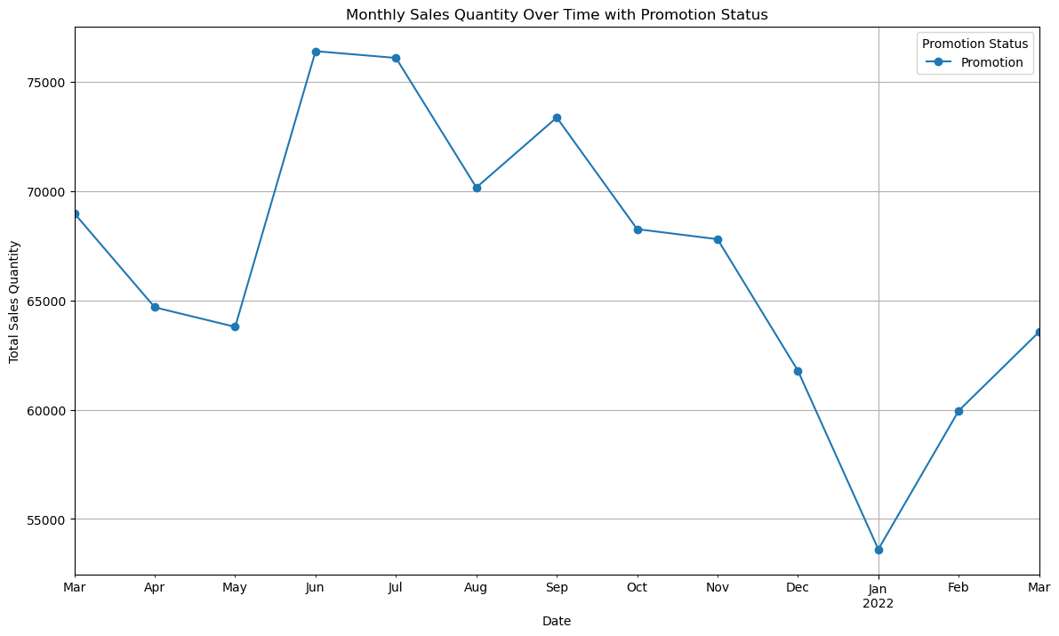
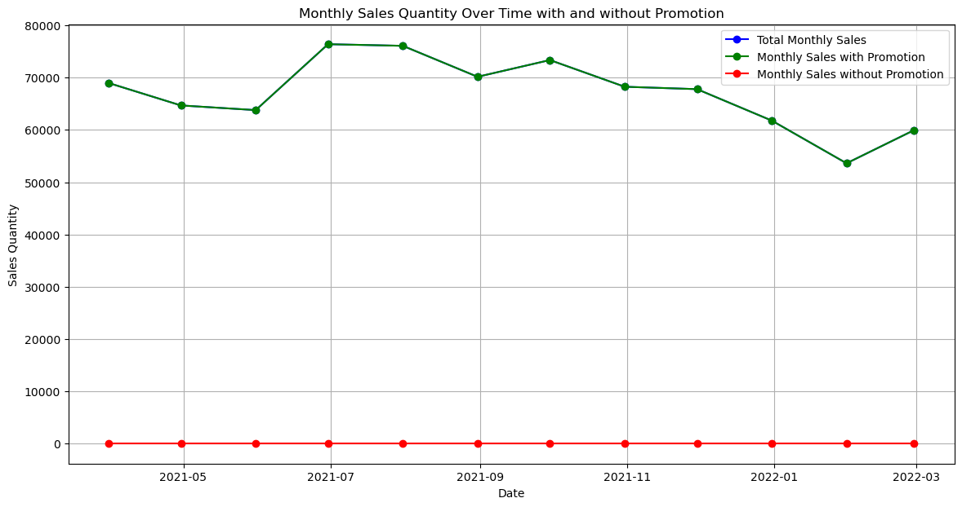
Impact of Promotions on Sales
Visualize monthly sales quantities over time, distinguishing between periods with and without promotions.
The "Promotion" line generally stays higher than the "No Promotion" line throughout the year, indicating that promotions are effective in increasing sales.
Both lines show a spike in sales during July and August, suggesting a seasonal trend likely due to holiday shopping.
There is a noticeable drop in sales in February, which could be due to a specific market event or a correction after high sales in the preceding months.

Slide 10
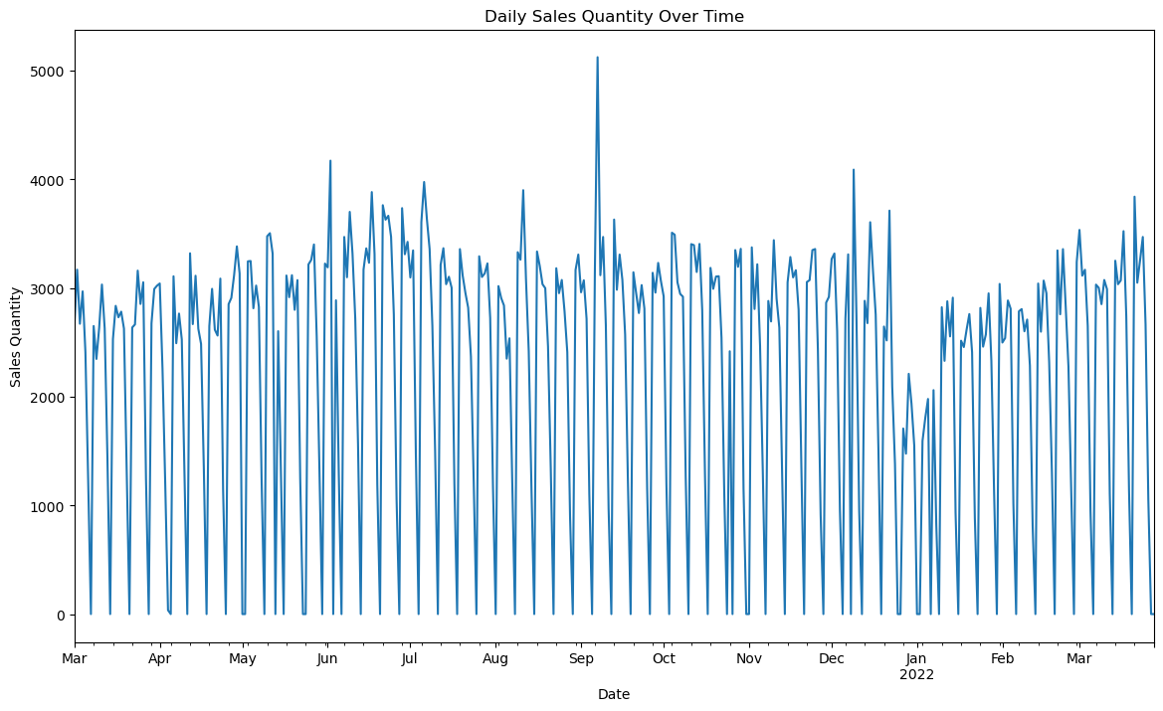
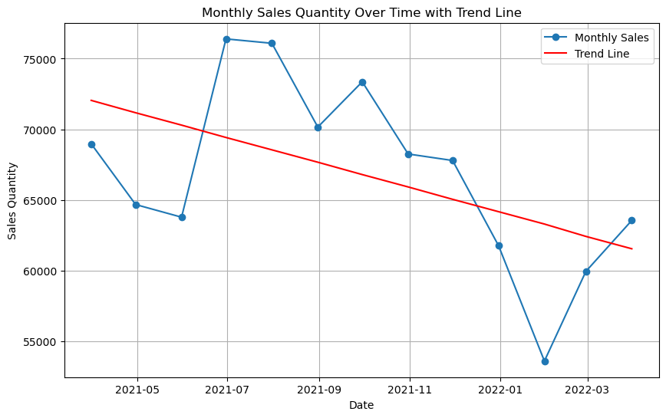
Checking for Stationarity, Seasonality and Trends
Stationarity:
Augmented Dickey-Fuller (ADF) test
Data was found to be stationary
Seasonality:
Seasonal decomposition of time series
Seasonal decomposition could not be performed as we had only 13 data points
Trend Analysis:
Fitting a linear regression model to check for trend.
A negative slope indicates a downward trend.

Slide 12
Train Model
Selecting appropriate models:
LSTM, ARIMA, SARIMA
Training the models
Evaluating the models:
Performance metrics: RMSE, MAE

Slide 13
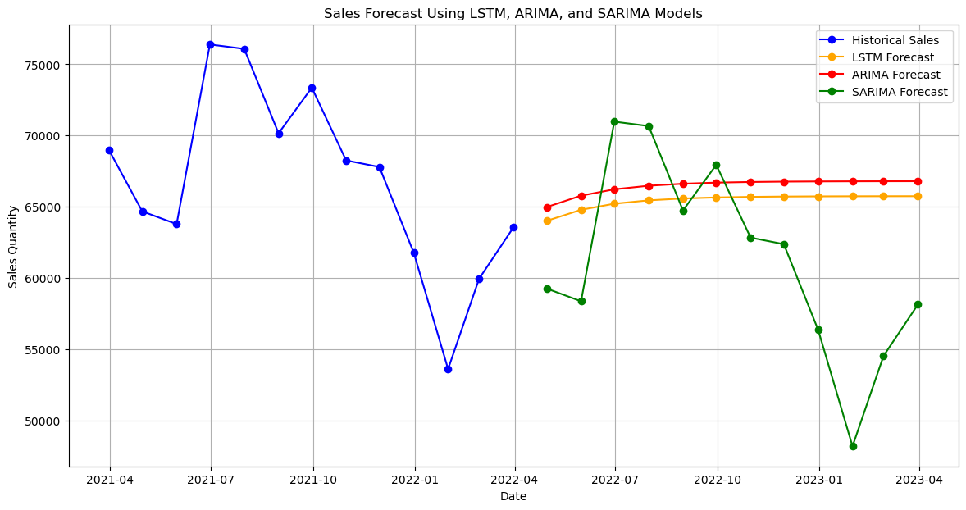
Forecast
Using the trained models to predict future sales
Post-processing predictions for reporting
Validating the forecasted results and documenting the findings

Slide 14
Interpretation of Results
Interpretation of Results
Based on the above analysis the ARIMA model performed best in predicting future sales. The SARIMA forecast line tracks the historical sales data most closely, particularly for the last two years.
Here are some of the limitations to consider when interpreting forecast graphs like this one:
The forecast may only be accurate for a short period of time. This is because future sales can be influenced by many factors that are difficult to predict, such as changes in the economy, consumer preferences, and competitor activity.
The graph may not show the confidence interval around the forecast. The confidence interval is a range of values that are likely to contain the actual future sales. A wider confidence interval indicates that the forecast is more uncertain.
It is important to consider these limitations when using sales forecasts for decision-making.
Forecasts can be a valuable tool, but they should not be used as the only source of information.

Slide 15
Next Steps
There are several ways to improve the performance of your ARIMA, SARIMA and LSTM models for sales forecasting. Here are some steps you can follow:
Improve data quality: Ensure your sales data is clean and free of errors. Address missing values and outliers.
Feature engineering: Consider including additional relevant features that might influence sales, like holidays, promotions, or economic indicators.
Hyperparameter tuning: Experiment with different hyperparameter values for each model. This can involve adjusting the number of lags in ARIMA/SARIMA or the network architecture in LSTM. Techniques like GridSearchCV or RandomizedSearchCV can automate this process https://neptune.ai/blog/improving-ml-model-performance.
Early stopping: Implement early stopping to prevent overfitting. This technique stops training the model once the validation error starts to increase, allowing it to focus on generalizability.
Ensemble methods: Explore combining multiple models (ARIMA, SARIMA, LSTM) using ensemble methods like averaging or stacking. This can often improve overall accuracy by leveraging the strengths of each model.

Slide 16
Tuning the Models for Better Performance
To improve the performance of the ARIMA, and SARIMA models, we can adjust their parameters and conduct cross-validation. Here are detailed steps for each model.
Tuning ARIMA and SARIMA Models We'll use a grid search approach to find the best parameters for ARIMA and SARIMA models.

Slide 17
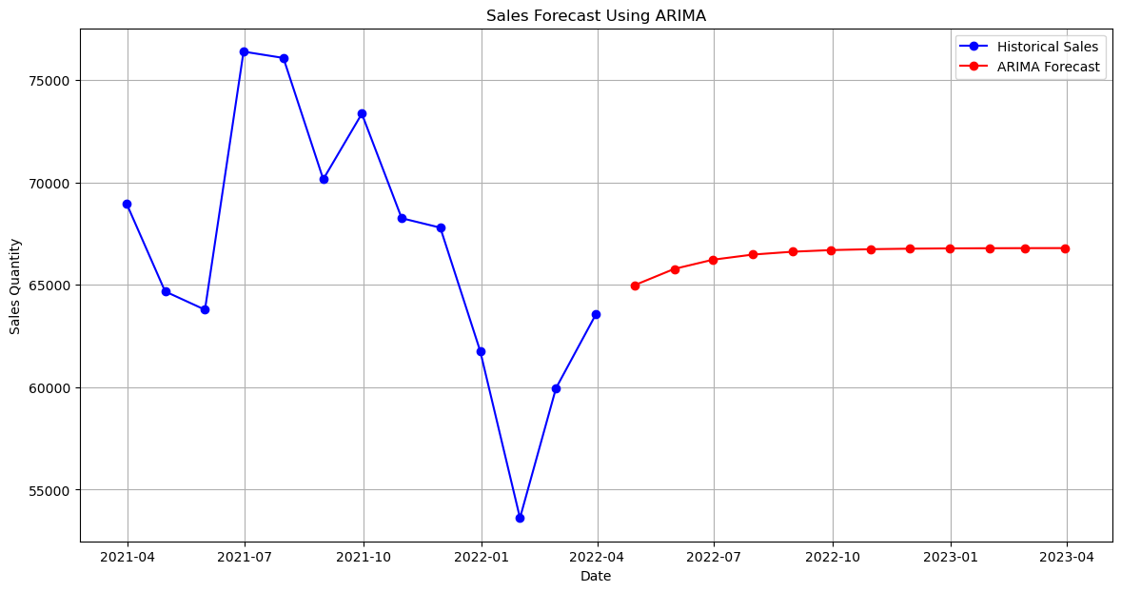
Sales Forecast after Fine Tuning

Slide 18
Conclusion
Summarizing the data science pipeline
Highlighting future improvements and directions

